Slide 1


Combat veterans motorcycle association
Presented by: Adam Crain

Slide 2
Customer and purpose
Combat Veterans that have served in all branches of the military who ride motorcycles as a hobby.
501(c)(3) charitable organization.
Provide funeral escort services
Provide direct support to veterans in need and support other veteran charitable organizations.
Notes:
The Combat Veteran’s Motorcycle Association is a 501c 3 charitable organization comprised of United States Armed Forces veterans, both active and prior service, who ride motorcycles as a hobby. Their charter is to continue to support the community from which they came from. This is done in a variety of ways such as providing motorcycle escorts for veteran funeral services, helping with necessary household projects for veterans in need, and conducting fund raisers in support of other charitable organizations.

Slide 3
Customer and purpose
Website with supporting database
Inform the public about organization and events
Provide information to potential members
Member discussion forum
Notes:
This purpose of this project is to provide the local Olympia chapter with a public facing webpage to inform the pubic about who they are and about upcoming association events. Additionally the page is there to provide information to potential members, a method in which to contact the organization, and provide a means for current membership to coordinate both motorcycle rides and fund-raising events together via a discussion forum.

Slide 4
Roles and responsibilities
Requirements Gathering
Webpage Design/Coding
Database Design/Development
Functional Testing
Security Testing
Webhosting Options
Presentation
Acceptance/Implementation
Notes:
Unfortunately there were no other computer science students who elected to work with me on this project. This made me responsible for all roles and responsibilities within this endeavor.
My initial requirements gathering with the chapter

Slide 5
Project schedule
TASK NAME | ASSIGNED TO | START DATE | DUE DATE | DURATION | % DONE
Project Proposal | Adam | 9/1/2019 | 9/15/2019 | 15 | 100
Requirements Gathering | Adam | 9/28/2019 | 10/10/2019 | 12 | 100
Functional Requirements / Priority Assignments | Adam | 9/30/2019 | 11/1/2019 | 30 | 100
Webhosting Options | Adam |  | 4/30/2020 |  | postponed
Database ER Diagram | Adam | 11/15/2019 | 12/6/2019 | 22 | 100
Database Design | Adam | 11/15/2019 | 12/6/2019 | 22 | 100
Webpage Design/Coding | Adam | 1/15/2020 | 3/15/2020 | 60 | 100
PHP Coding | Adam | 2/16/2020 | 3/15/2020 | 30 | 100
Testing (Functional / Security) | Adam | 3/15/2020 | 4/15/2020 | 30 | 100
Presentation/Acceptance | Adam | 4/16/2020 | 5/6/2020 | 20 | postponed
Implementation | Adam | 4/16/2020 | 5/6/2020 | 20 | due to COVID-19

Slide 6
Budget considerations
Technologies with No Cost to Customer
Coding (HTML, CSS, JavaScript, PHP)
Free Software (phpBB, Google account)
Security Testing (Skipfish, NMAP, Security Ninja)
Webhosting expenses
BlueHost $4 + per month
GoDaddy $6 + per month
HostGator $4 + per month

Slide 7
risk considerations
Safeguarding Personally Identifiable Information (PII)
Database Security
Password protection (encryption)
Data backup
SSL Certificate (https)

Slide 8
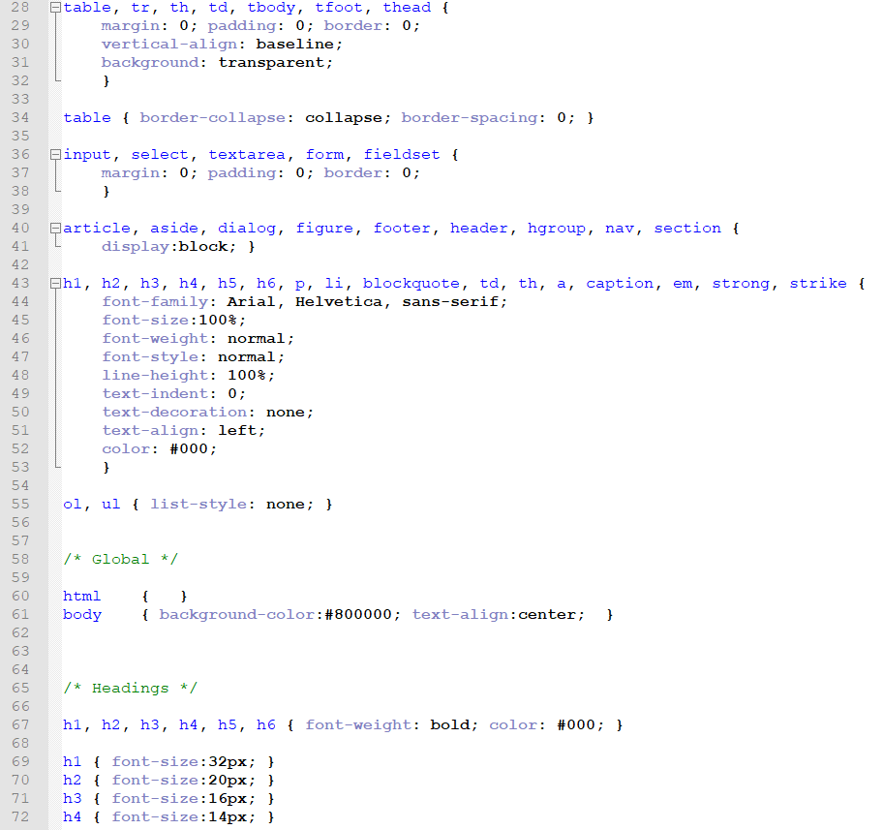
css

Slide 9
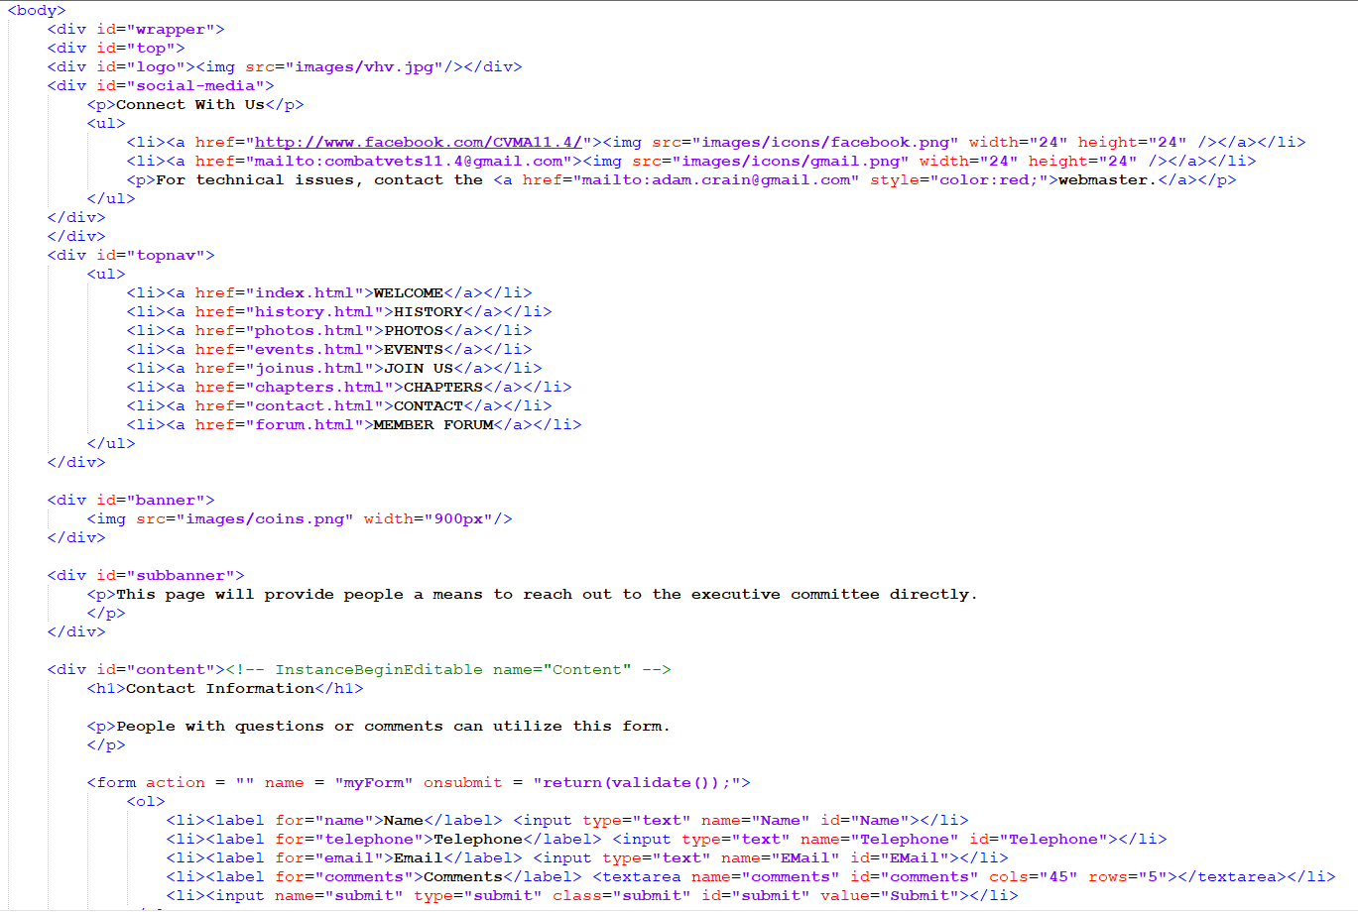
html

Slide 10
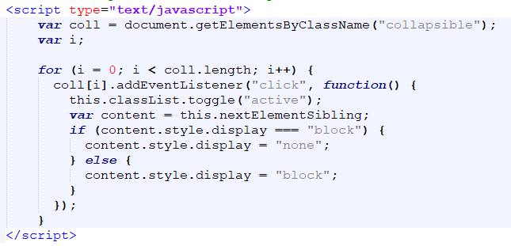
javascript

Slide 11
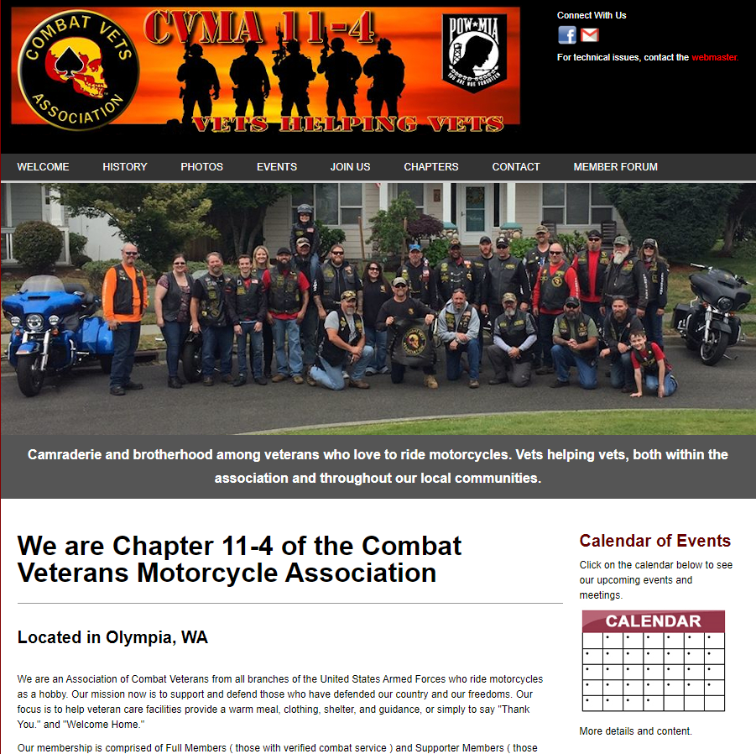
Webpage layout

Slide 12
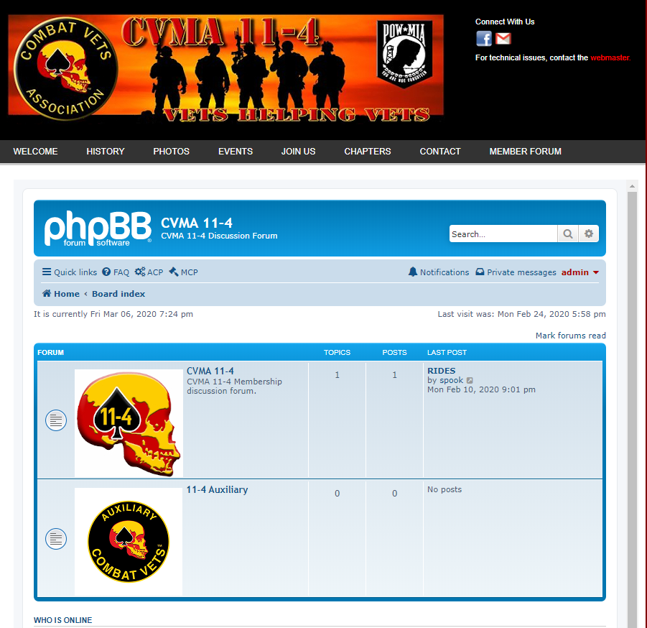
Discussion Forum Design

Slide 13
Functional testing
Test all navigational links
Test all downloads
Test for compatibility with all major web browsers
Security testing
Port Scan - NMAP
Vulnerability Testing – Skipfish/Security Ninja

Slide 14
Implementation and turnover
Establish service with customer approved web service provider
Train association representative to:
Update Pages
Reset User Passwords
View Audit Logs
Elevate or reduce user privileges

Slide 15


